Slide 1
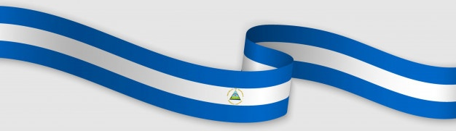
Government of Reconciliation and National Unity
Property and Legal Security of Land Tenure in Nicaragua

Slide 2
Major Transformations of Tenure of Land in Nicaragua
1979-1989
-Massive Agricultural Reform for traditional farmers
-Urban Social Reform
1990-2006
-Demobilization Agreements
-Massive land distribution for demobilized soldiers
-Land titling at a lower scale
2007 to date
-Massive land titling, includes Indigenous Peoples
-Coverage of the National Registry
-Strengthening Records
- Strengthened legal and institutional framework

Slide 3
To understand the GRUN's efforts since 2007, it is imperative to know what we received from previous Governments
Archipelago of Structures
Institutional inconsistency.
Property insecurity
(under an Organized Crime Network)
Registration without control of transactions, on state properties.
Property conflicts
Titles upon titles, or to people who did not have possession.
Duplication of Efforts.
State properties without registration.
Opposition to agricultural reform
Undetermined and confusing property claims, up to Double Compensation
Property conflicts over Liquidated Banks.
Land trafficking.
Overlapping topographic plans and registry accounts, on the same property.
Land dispossession for small producers.

Slide 4
Since 2007 we carried out a
STATE POLICY: EFFECTIVE MANAGEMENT OF PROPERTY.
Judicial Branch
Municipalities
Legislative Branch
Executive Branch
INSERTING US ALL
To Strengthen the Legal Security of All Nicaraguans.

Slide 5
And we began to articulate all the institutions, based on a National Plan for Human Development.
For the ordering of national cartography and surveying of uncategorized areas
To stop judicial proceedings, with which they illegally appropriated lands of the State
To curb real estate abuse over Private and State areas.
Ineter
Ministry of Environment and Natural Resources
Ministry of Agriculture
Army
Central Bank
National Corporation of the Public Sector CORNAP
Public records of property
Property Management
National Commission for Demarcation and Titling of Indigenous Lands
Supreme Court of Justice
Attorney General / Property Intendance
Municipalities
To consolidate the autonomy of municipal and coastal lands, as well as to encourage effective taxation.
To compensate the State for abuses and legalize the lands of thousands of families, small producers and demobilized soldiers
For compensation to the State and the former workers of the State Owned Companies, affected by privatization.
For the delimitation of
protected areas
For the delimitation of
Violated Production Areas
For the recovery of real estate derived from bank failures
To protect border areas, in search of sovereignty
For the legalization of the territories of the Caribbean Coast

Slide 6
And we started working to:
Create a State Assets Unit: Derived from the recovery of the Residual Assets from the Extinct Banks (BAMER, BANCAFE, BANIC, INTERBANK and BANCOSUR):
Stop Irregular Indemnities: We guarantee that the Claimants presented their documents correctly and we verified that they had no debts with the National Financial system. We dismissed assets with debt issues.
Apply the Agricultural Law of 1917: On properties adjacent to rivers, lakes, lagoons and coasts, that by rule of law belong to the Nicaraguan State and we stopped the Land Trafficking at the national level.
Strengthen coordination with the Commission for Peace and Reconciliation: For the attention and resolution of property conflicts, thus contributing to social peace.
Consolidate a Demarcation and Land Titling Process for the Indigenous Communities of the Caribbean Coast: Under the Framework of its Law No. 445 that harmonizes culture, traditions and customs of its inhabitants.
Guarantee the legality for properties where State institutions operate: To prevent these from being dispossessed: Schools, Hospitals, Health Centers, Police Stations and other institutions of the Executive Power.
Ensure the qualification to the beneficiaries of the Urban and Rural social reform: With a true gender equity.
Close the Waiver: As of 2007, we received 678 assets, belonging to 325 citizens (of which only 17 were true Americans) as pending settlement.
.

Slide 7
With ordered structures; The GRUN has issued:
434,653 Property Titles; restoring the right to 1.8 million Nicaraguan families.
2007: 8,902
2008: 16,866
2009: 24,253
2013: 26,734
2014: 20,758
2015: 27,625
2019: 23,263
2020: 24,957 programmed
2020: 16,223have been issued as of July:
2010: 37,269
2011: 70,288
2012: 53,509
2016: 55,200
2017: 34,348
2018: 19,415

Slide 8
Land Titling compared to the 16 years of neoliberal governments:
1990-2006
434,653

Slide 9

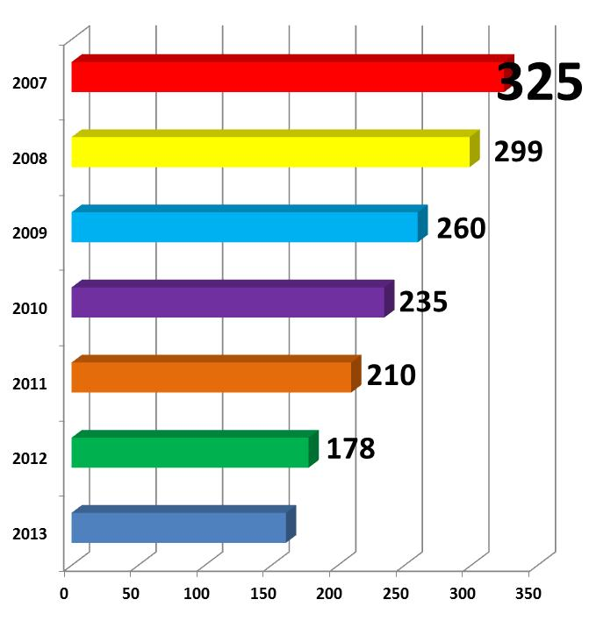
What we received and we were solving
Claimants accepted
91
2014

Slide 10
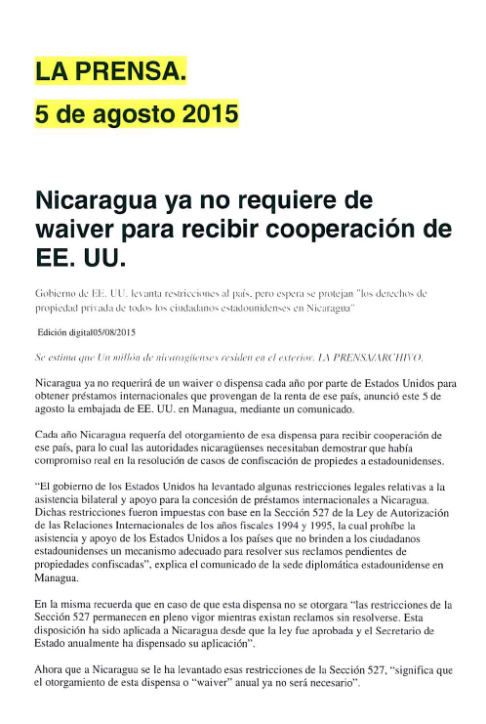
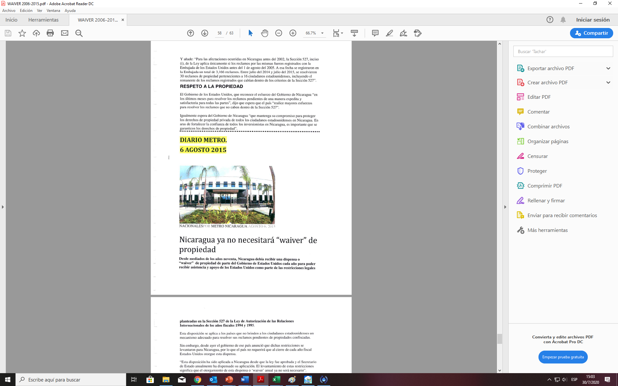
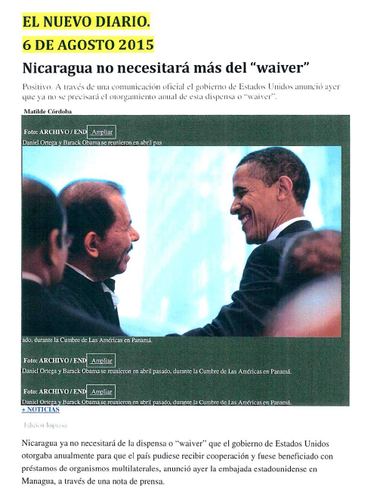
and it was possible to close the so-called Waiver in 2015
Violeta Barrios and Arnoldo Aleman paid: USD$ 1,104 MM.
Enrique Bolaños paid: USD$ 103 MM.
GRUN paid in 8 years: USD$ 37 MM.

Slide 11
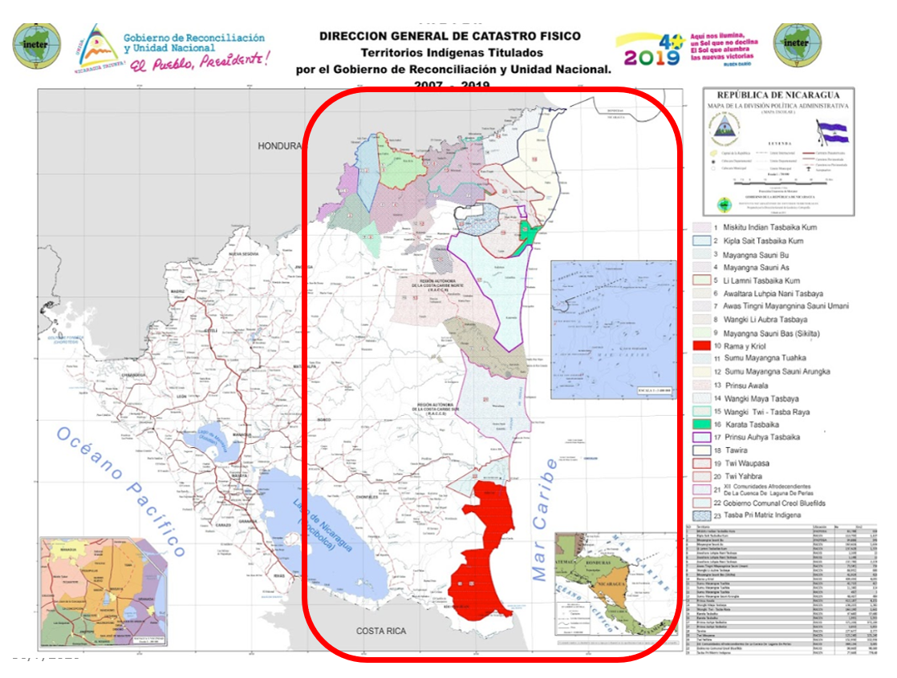
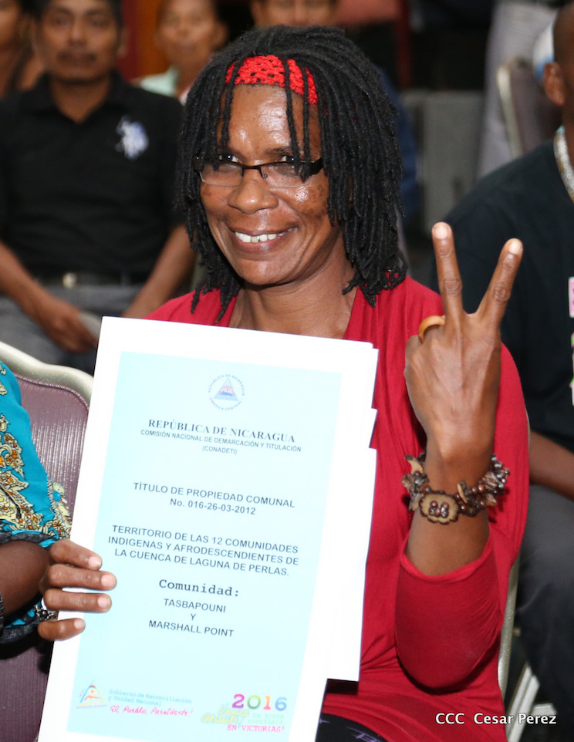
For the first time, the GRUN restored the ancestral rights of the indigenous and ethnic peoples and communities of the Caribbean Coast, Bocay, Coco, Indio and Maize Rivers, legalizing their lands.
23 Indigenous Territories TITLED:
  304 Ancestral communities.
  39,531 Families, for a total of: 227,185 people.
  37,841 km2 Titled.
  Equivalent to 31.16% of the National Territory and 19% of the Caribbean Coast.

Slide 12
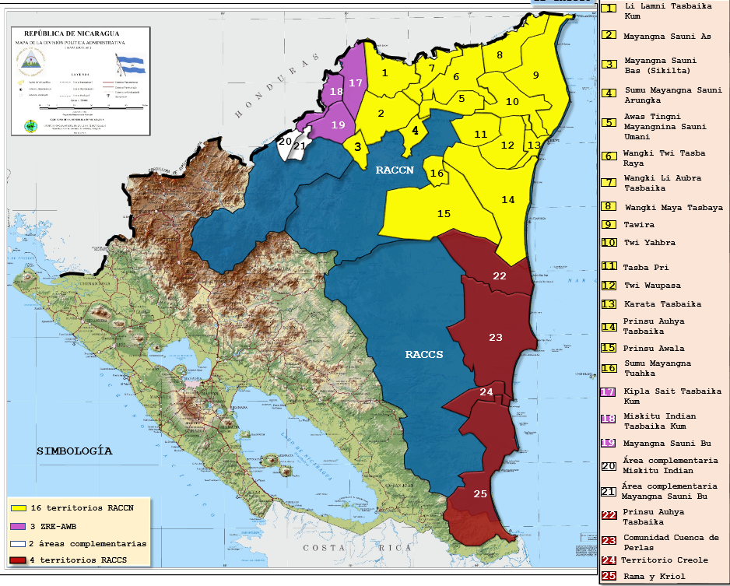
In the Special area of Alto Wanki and Bocay, the last 2 titles for the Native Communities of that area will be ready at the end of 2020:
Settled in the Bosawás Biosphere Reserve, Alto Wangki and Bocay Special Zone:
Mayangna Sauni Bu.
Miskitu Indian Tasbaika Kum.
11 indigenous communities will benefit, comprising:
514 families (2,353 people).
and with an area of: 592.82 Km².
Representative map of what by the end of 2020 will have been legalized by the GRUN to the original communities of the Caribbean Coast since 2007.

Slide 13
Nuevos departamentos en proceso de de establecimiento del Catastro en los municipios de Rio Blanco y Rancho Grande de Matagalpa y Juigalpa del Departamento de Chontales. Previsto para los próximos años el establecimiento del Catastro en el restante de los Departamentos de Boaco, Chontales y Rio San Juan.
Catastro en municipios con Pueblos Indígenas. Como parte del establecimiento del catastro, se ha brindado una atención especial y diferenciada a los municipios de Mosonte, Telpaneca, Las Sabanas y San José de Cusmapa donde existen pueblos indígenas, concluyendo el catastro de manera satisfactoria y con alta participación de la población indígena. De igual manera, se avanza en el catastro del pueblo indígena de Jinotega y del municipio de Santa María de Pantasma. Este esfuerzo del GRUN incluye la instalación de un Sistema Catastral para Pueblos Indígenas.
The Restitution of Land Rights is not unrelated to the modernization of the governing institutions in this field.
Since 2007, work has been done to declare 6 Departments as registered areas, which were not previously.
And we continue to work in the same direction –currently-, in the municipalities of Rio Blanco, Rancho Grande, Juigalpa, Boaco and San Carlos
Esteli
Madriz
Leon
Nueva Segovia
Jinotega
Chinandega
San Carlos
Boaco
Juigalpa
Rancho Grande
Rio Blanco

Slide 14
This massive process of ordering and titling properties has contributed to economic sustainability, governance and social harmony; mainly in the rural area.
The legal, institutional and technical framework for the administration of property rights has also been strengthened, which provides a higher quality service to the population, benefiting men and women on equal terms, both in urban and rural sectors.
THANK YOU

